Slide 1
ITEM PCA

Slide 2
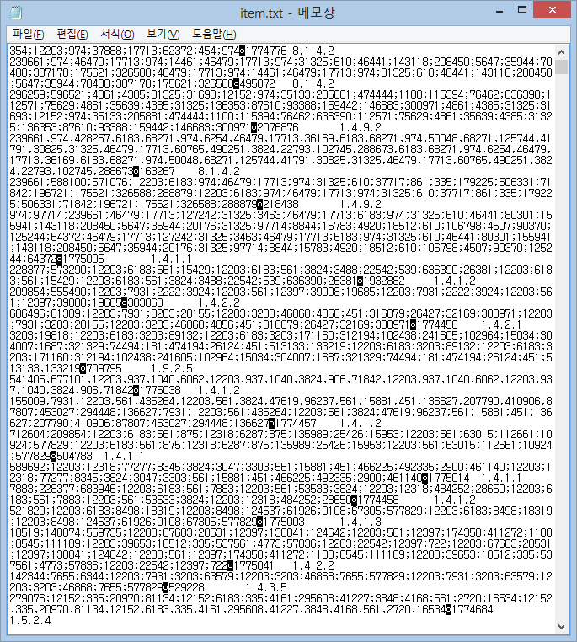
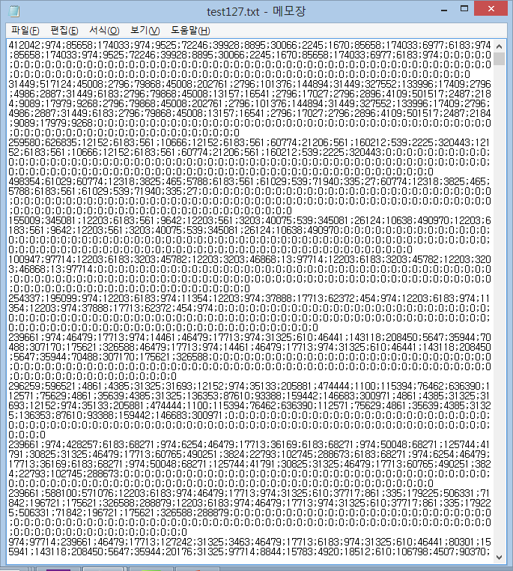
총6095
Min:1
Max:127
Avg:33
Upperquarter:45
User:고유
Category:중복존재
Category같아도 keywords다름

Slide 3
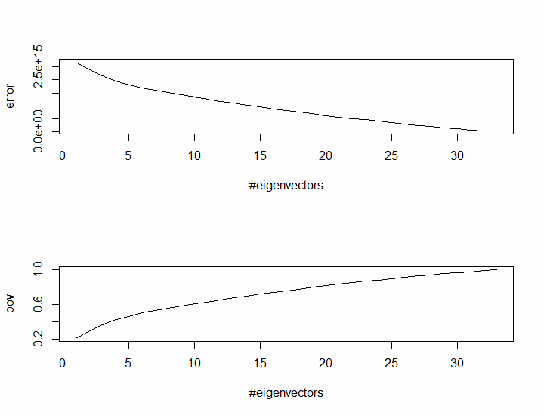
Dimension n=33

Slide 4
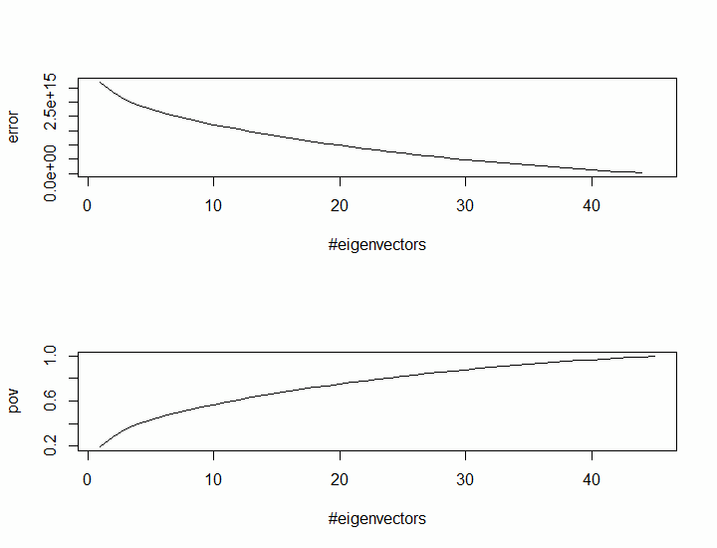
Dimension n=45

Slide 5
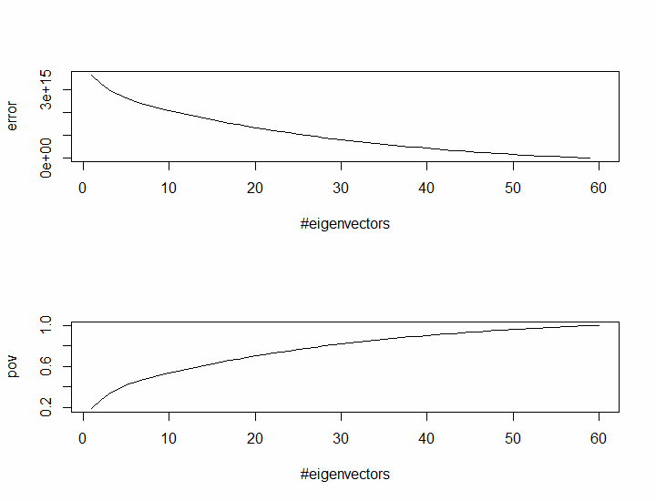
Dimension n=60

Slide 6
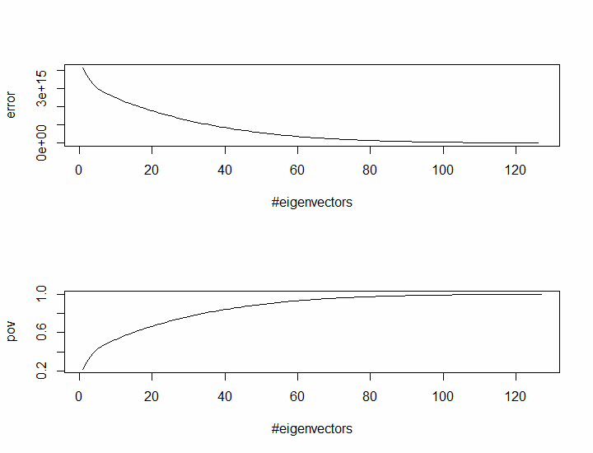
Dimension n=127

